Slide 1
HRS Parameters
and Optics
Jin Huang & Vincent Sulkosky
Massachusetts Institute of Technology
Boson 2010 Workshop
Sept 20, 2010 @ JLab

Slide 2
HRS Parameters and Optics
General Optics and HRS
Optics Calibration for June Test
General Optics/Hall A HRS/Optics for APEX
Optics for Full Scale Running
Angular Calibration/Momentum Calibration
Vertex/Beam correction/Expected Precision

Slide 3
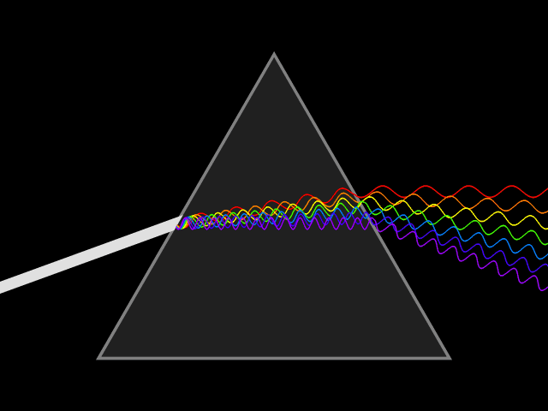
Optics As Everyone Knows
Dispersive prism + detector
Analyze wavelength (momentum) of incoming light
Dispersive
Prism
Detector
Array
Optics Reconstruction:
@ Detector
Position
Direction
Inverse Prism
Transportation
@ Source
Momentum
Direction

Slide 4
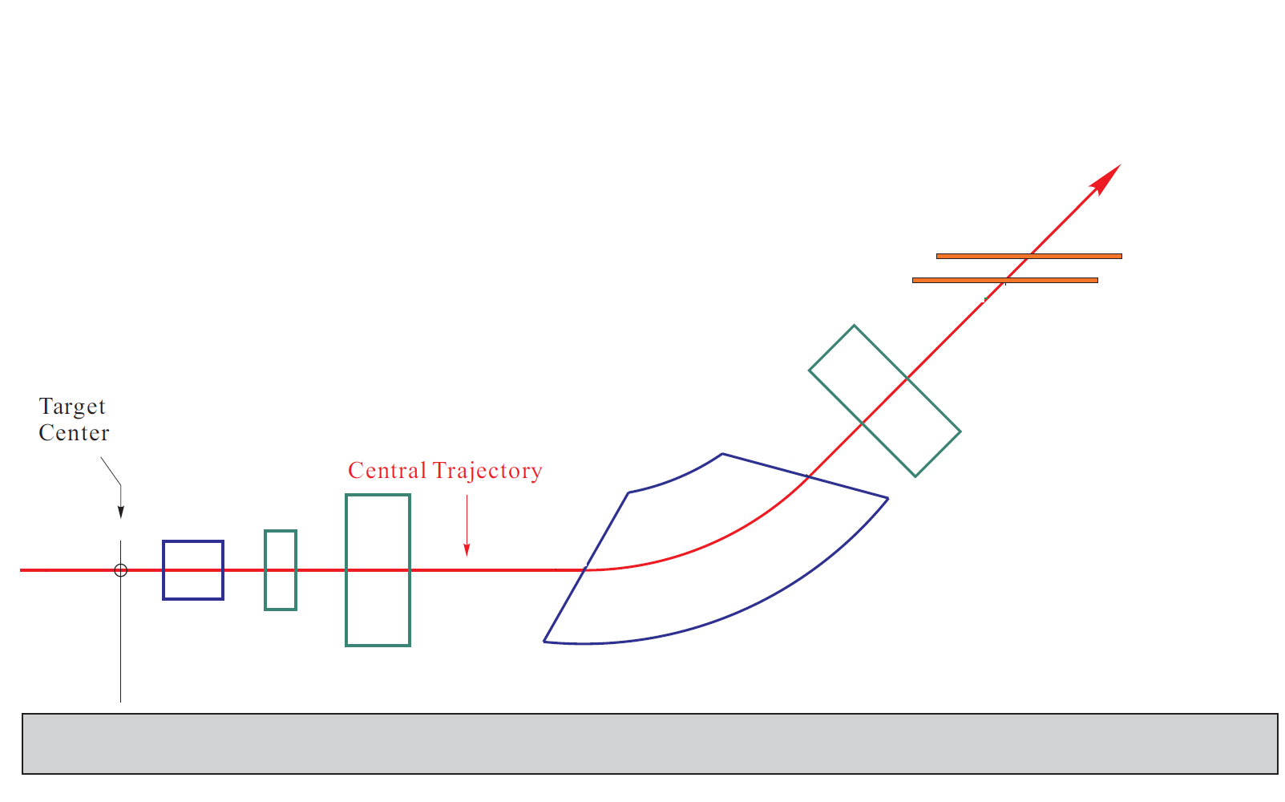
Magnetic Spectrometer Optics
Dispersive Dipole Magnets + Tracking Detectors
Analyze incoming charged particle
Momentum (3D Vector)
Vertex Position
Optics = A functional formula
Multivariable input/output
Tracking Detectors
Dispersive
Dipole
Other Magnet Components
Notes:
Add septum bending image

Slide 5
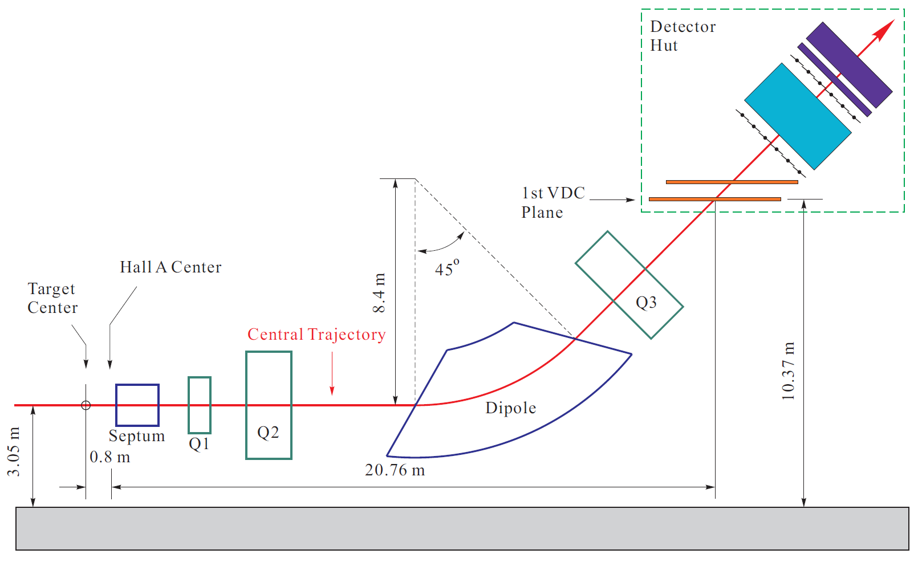
High Resolution Spectrometer (HRS) for APEX
Setup
QQDQ vertical bending 45º, well studied over years
Septum magnet to access scattering angle to 5º
Vertical Drift Chamber (VDC) for tracking
Acceptance w/ septum
Momentum ±4.5%
Angle ±20mrad (H); ±60mrad (V); ~5msr
Vertex >50cm @ 5º
Top view
Notes:
QQDQ -> Expand

Slide 6
Optics for APEX
Use tracking information on VDC
2D hit position/2D angle
Reconstruct target side
Small acceptance, large size → Fine res.
Momentum σ~1×10⁻⁴(Rel. to p₀)
Angle σ~0.5mrad (H) , 1mrad (V)
Vertex σ~1cm, Trans. Pos. σ~1mm
+Target multi-scattering (~0.4mrad on angles)
Uncertainty contribution
Tracking precision
Optics calibration precision
Notes:
Septum bending small

Slide 7
Uncertainty in optics
Central angle
Momentum dev.
H. angle diff
V. angles
Inv mass uncertainty (ex. Kine A)
To leading order:
Momentum Contribution is small
σ~1×10⁻⁴ → δm~20keV
Vertical angle res. is minor too
σ~1mrad → δm<120keV
Diff of horizontal angles res. dominates
σ~0.5mrad → δm~570keV
Sum of horizontal angles -> high order
Systematic offset of diff -> do not contribute to peak width
+Target multi-scattering
~0.4mrad (~500keV on δm), target design dependant
Notes:
Specify p0~1GeV, m^2=200meV^2

Slide 8
Calibrating optics
Reconstructing optics
Input: Track position/direction, Beam location
Output: 3D momentum, vertex
Formula: 4D polynomial fitting & interpolation
Separating into 3 groups calibration
Angles
Sieve slit data
Momentum (dp = momentum/central -1)
Elastic data
Vertex
Multi-foil data

Slide 9
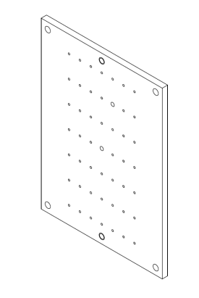
Test Run Calibration / Angles
Septum
Entrance
Calibrate with
Elastic scattered electrons
Sieve slit
Scan through acceptance
Sieve plate survey define angle offsets
“Central Angle” is arbitrarily defined
Relative distance between two sieves → offset of angle difference
Possible improvement: single sieve slit for both arm
Other contribution (δm less sensitive to)
Beam position
Foil location
Beam
e’
Sieve Plate
Vertex

Slide 10
Test Run Calibration / Angles
Before Calibration
Calibrated with June test run data
Elastic peak + Elastic tails events
Acceptance reduced
PREX collimation
Full running : larger acceptance
1st iteration calib done
Example plots ->
Calibration precision
Horizontal 0.2mrad
Vertical 0.3mrad
Average center offsets of reconstructed sieve hole spots
Point to point precision
Sieve V. Pos [m]
Sieve
After Calibration
Sieve V. Pos [m]
Sieve H. Pos [m]
Notes:
Reduced by PREX colimator by how much !!
Total spherical angle

Slide 11
Test Run Calibration / Momentum
Few 10⁻³ level good out of box
Calibration
Select elastic scattered electrons events
Fit reconstructed momentum →elastic calc.
Tested with June data
0%<=dp<=4%
Well developed procedure for full running
One elastic peak
scan p₀ to calib. Full acceptance
Offset + Res. [10⁻³×p₀]
(p/p₀-1)– elastic angular dependence

Slide 12
Calibration / Vertex
Septum
Entrance
Not included in test run
Old optics target
Calibration method
Separated foil target
Each foil form a stripe on 2D plot
Horizontal angle
Horizontal position
Calibration
Select each stripe
Fit towards surveyed foil location
Beam
e’
Foil
target
Each foil shown as a stripe
Calibrated vertex
7cm
Vertex z [m], E06010 data @ 16º
Notes:
Which experiment data shown

Slide 13
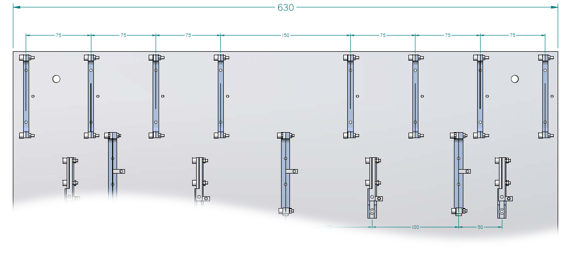
Full running optics target design
Multi-array target
Significantly improve foil separation during calib.
Enough foils for reliable interpolation
Carbon Foils
Foil Array 1
Foil Array 2

Slide 14
Beam Correction
Two part optics reconstruction
Approximate target variable with ideal beam
Apply correction with beam location
Leading beam correction on 3D momentum
0.5mrad on vertical angle / 1mm vertical beam shift
0.2×10⁻³ on dp / 1mm vertical beam shift
0.04mrad on horizontal angle / 1mm vertical beam shift
Rest correlation are 2nd order or higher
Calibrating the correction coefficients
Theory calc. : 2009 Hall A Analysis Workshop talk
Fit from data
Consistency between methods (tested w/o septum)

Slide 15
Optics for full scale running
Lots of experience from test run
Optics data
Two data sets: 5.0º @ 1pass, 5.5º @ 2pass
Each HRS, data taken separately (septum mod)
Elastic scan on 2 carbon foils arrays, w/ sieve
7 mom. point: 0%, ±2%, ±3%, ±4% relative to central p₀
Momentum and angular calibration
Inelastic run on 2 carbon arrays, w/o sieve
Vertex calibration
+ beam correction check
Beam time
2× (2×~1Shift+Conf. Change) ≲ 2 day
Notes:
Summary of beam time

Slide 16
Conclusion
APEX HRS spectrometers
Resolution of diff. between H. angle dominants δm
June test run
Optics calibration precision (point to point)
0.3mrad (V. Angle), 0.2mrad(H. Angle), (1~2)×10⁻⁴ (p/p₀)
Learned a lot toward better preparing full production optics
 | Acceptance | Resolution as σ
Momentum | ±4.5% (Rel. to p₀) | 1×10⁻⁴ (Rel. to p₀)
Horizontal Angle | ±20mrad | 0.5mrad + ~0.4mrad(multiscattering)
Vertical Angle | ±60mrad | 1mrad + ~0.4mrad(multiscattering)
Vertex | >50cm | 1cm (along beam)

Slide 17
Back up slides
Vertex acceptance
1st order matrix

Slide 18
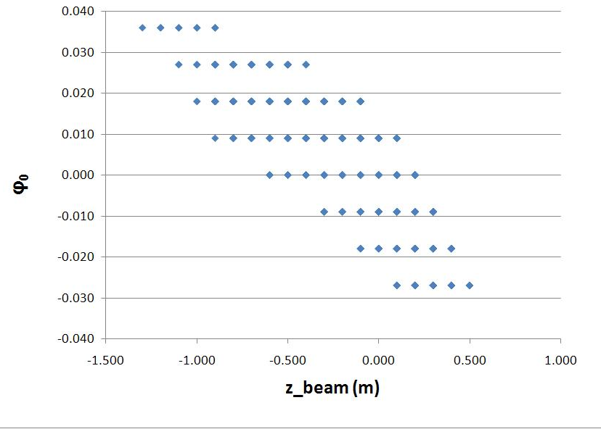
Vertex acceptance
Correlated with horizontal angular acceptance
(PREX) Collimated Acceptance
50cm long target

Slide 19
1st Order Optics Matrix
Arbitrary Trajectory
Define of optics variables
APEX optics tune
y
Reference Trajectory
x
ρ₀
Magnetic Mid-plane
Target side variable
Detector side variable
: New w/ septum and APEX tune

Slide 20
Inverse polarity
Repeatability of HRS polarity inversion
Guild line from John Lerose
Special cycling precedure
Verified in June test run, under analysis

